Slide 1

From raw data to robust connectivity analysis
Arnaud Delorme
Swartz Center for Computational Neuroscience, UCSD, La Jolla, CA, USA

Slide 2
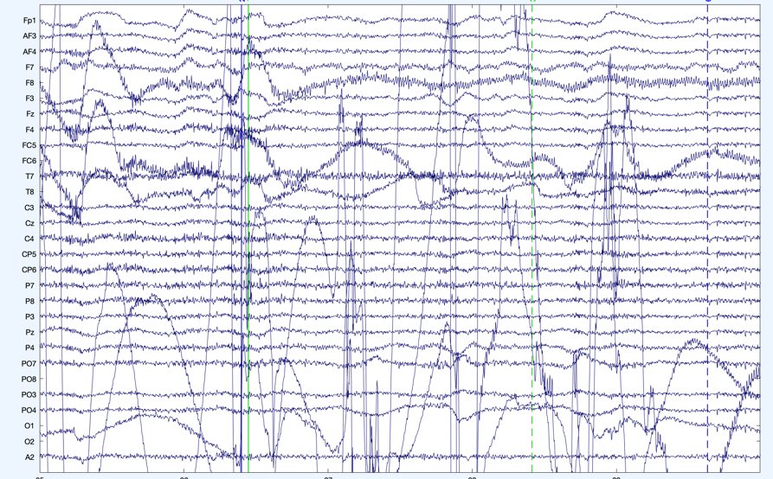
01.
Why preprocess data?
Measuring EEG data out of the recording device is like measuring a difference of potential on an oscilloscope.
To make sense of the data, we need to:
Before we do all that, we apply a series of transformations to the data
Extract meaningful measures from it (such as brain oscillations; brain source activations)
Compare brain data in different conditions
Assess reliable changes due to external stimuli (event-related potentials)
2
Notes:
There are several reasons why preprocessing is necessary for EEG data. First of all, the signals that are picked up from the scalp are not necessarily an accurate representation of the signals originating from the brain, as the spatial information gets lost. Secondly, EEG data tends to contain a lot of noise which can obscure weaker EEG signals. Artifacts such as blinking or muscle movement can contaminate the data and distort the picture. Finally, we want to separate the relevant neural signals from random neural activity that occurs during EEG recordings.
As EEG preprocessing is still an active area of research, there is no universally adopted EEG preprocessing pipeline, which means that researchers have some freedom in choosing how to transform the raw data. Below are some questions that might help you choose the more appropriate preprocessing techniques:
What kinds of artifacts might be present in your data? Which ones do you want to remove, and which ones do you want to flag to be aware of?
For example, depending on your experiment eye movements and blinking could be considered a source of noise but they could also reveal important patterns
Is your analysis being done online or offline?
If you’re preprocessing data as soon as it arrives, you might not be able to use more computationally expensive methods
Which features do you want to focus on?
For example, if you want to look at event-related potentials (ERPs), you will need to have accurate temporal information, whereas for motor imagery classification you will need accurate spatial information
Finally, keep in mind that even the best preprocessing techniques will not be able to account for bad data - if your subjects weren’t performing the task correctly or weren’t paying attention to the task or if your equipment was malfunctioning, it may be best to simply run the experiment again, rather that trying to salvage the data.

Slide 3
Pre-processing pipeline
Collect
EEG data
Import data
Import event markers
and channel locations
Re-reference/
down-sample
(if necessary)
Filter the data
Examine raw data
Identify/reject
bad channels
Reject large artifact
time points
Run ICA and
reject components
Done

Slide 4



What is BIDS?
BIDS is a way to organize your raw data
To improve consistent and complete documentation
To facilitate re-use by your future self and others
BIDS is not
A new file format
A search engine
A data sharing tool

Slide 5


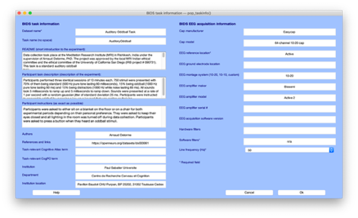
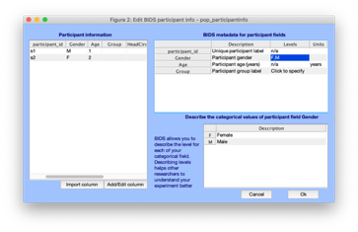
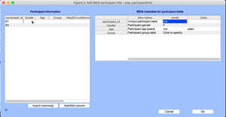
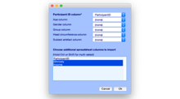
BIDS in popular open-source tools
Have dedicated tools for processing group-level data
EEGLAB bids-matlab-tools menus
and script functions (1450 downloads)
All tools can import BIDS single subject data (FieldTrip and EEGLAB support BIDS sidecar event files)
All tools can export BIDS data (GUI available in Brainstorm and EEGLAB)
Brainstorm and EEGLAB have dedicated BIDS tools for group analysis

Slide 6
Pre-processing pipeline
Collect
EEG data
Import data
Import event markers
and channel locations
Re-reference/
down-sample
(if necessary)
Filter the data
Examine raw data
Identify/reject
bad channels
Reject large artifact
time points
Run ICA and
reject components
Done

Slide 7
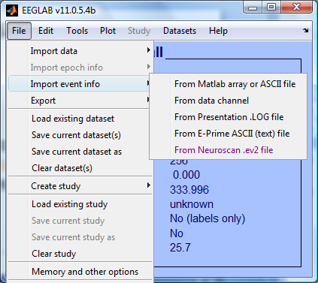
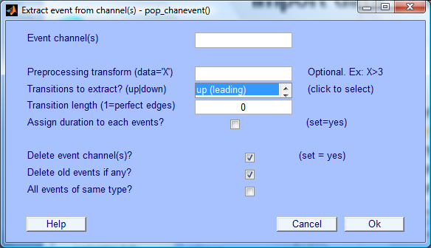
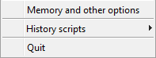
Import data events
Import events from Matlab array or ASCII file
Import events from data channel
Import from Presentation event file
Import events from E-Prime event file
Import events from Neuroscan event file
73
(Often imported automatically
during data import)

Slide 8
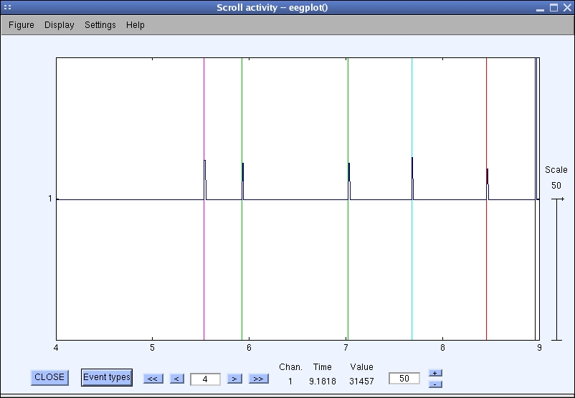
Appearance of an event channel in raw data

Slide 9
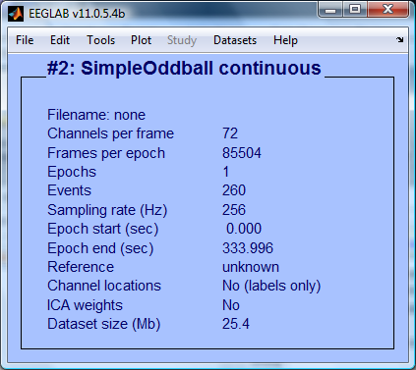
Imported data events
If event import was
successful,
you will see an
appropriate
number here

Slide 10
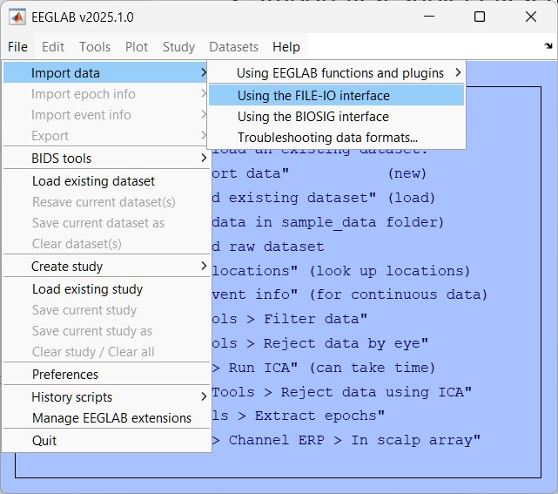
Import data
Open matlab
Start eeglab
Import first subject first run meeg .fif datafile from ds000117 dataset
Path : ds000117_pruned\derivatives\meg_derivatives\sub-01\ses-meg\meg\
File : sub-01_ses-meg_task-facerecognition_run-01_proc-sss_meg.fif

Slide 11
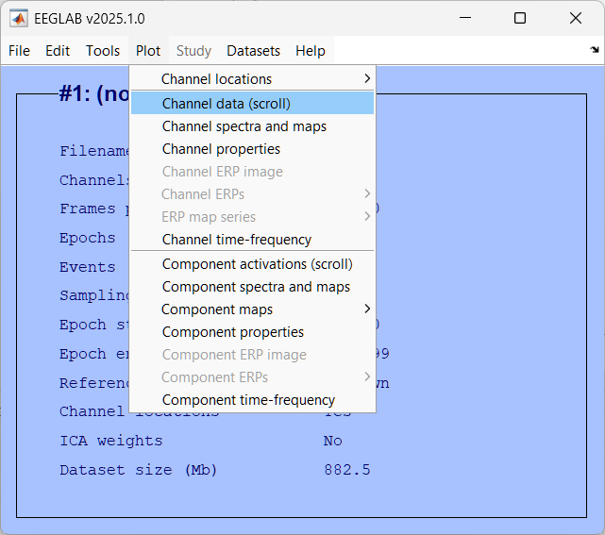
Plot channels timecourse

Slide 12
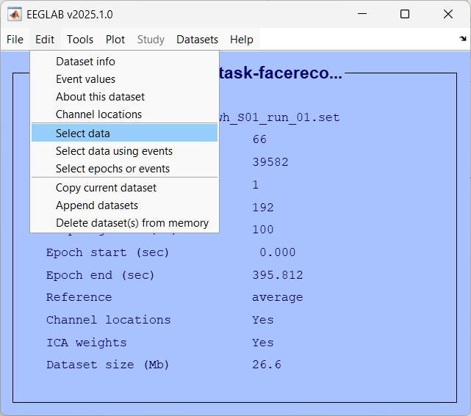
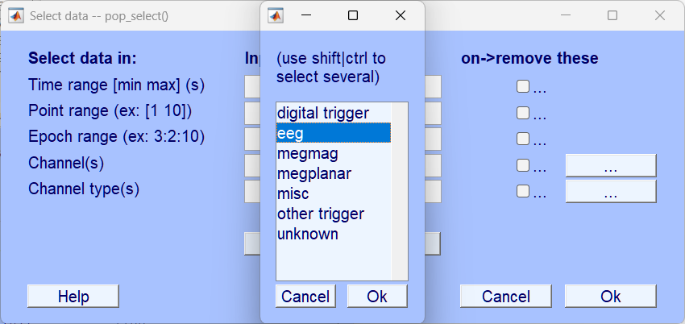
Select EEG channels

Slide 13
Check again signal timecourse

Slide 14
Hands on: Basic data loading and plotting
Start EEGLAB
Import FIF file using menu item File > Import data > Using File-IO ds000117_pruned/derivatives/meg_derivatives/sub-01/ses-meg/meg/sub-01_ses-meg_task-facerecognition_run-06_proc-sss_meg.fif
Use menu item Edit > Select data to select all the channels of type EEG
Use menu item Plot > Scroll data to scroll the data. Use menu Edit > Channel locations to inspect channel locations
Note: Because the data was collected in an MEG machine, it is complex and is preprocessed by the script script_01_import_data.m including renaming and realigning events. In future lectures, we will use the result of that script. If it has not already been executed for you on that folder, you will need to execute it.

Slide 15
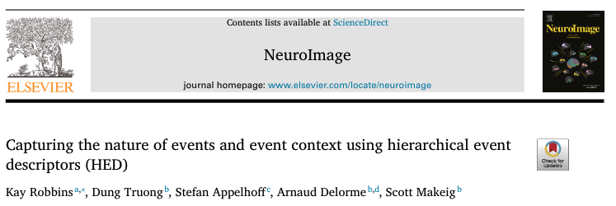
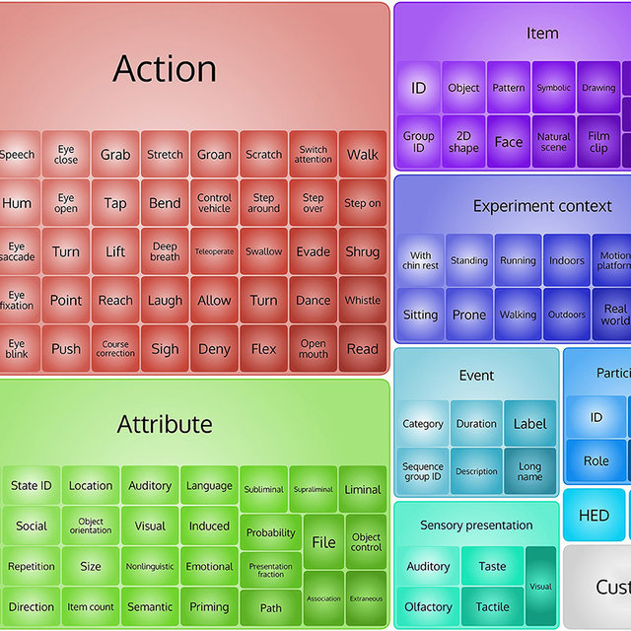
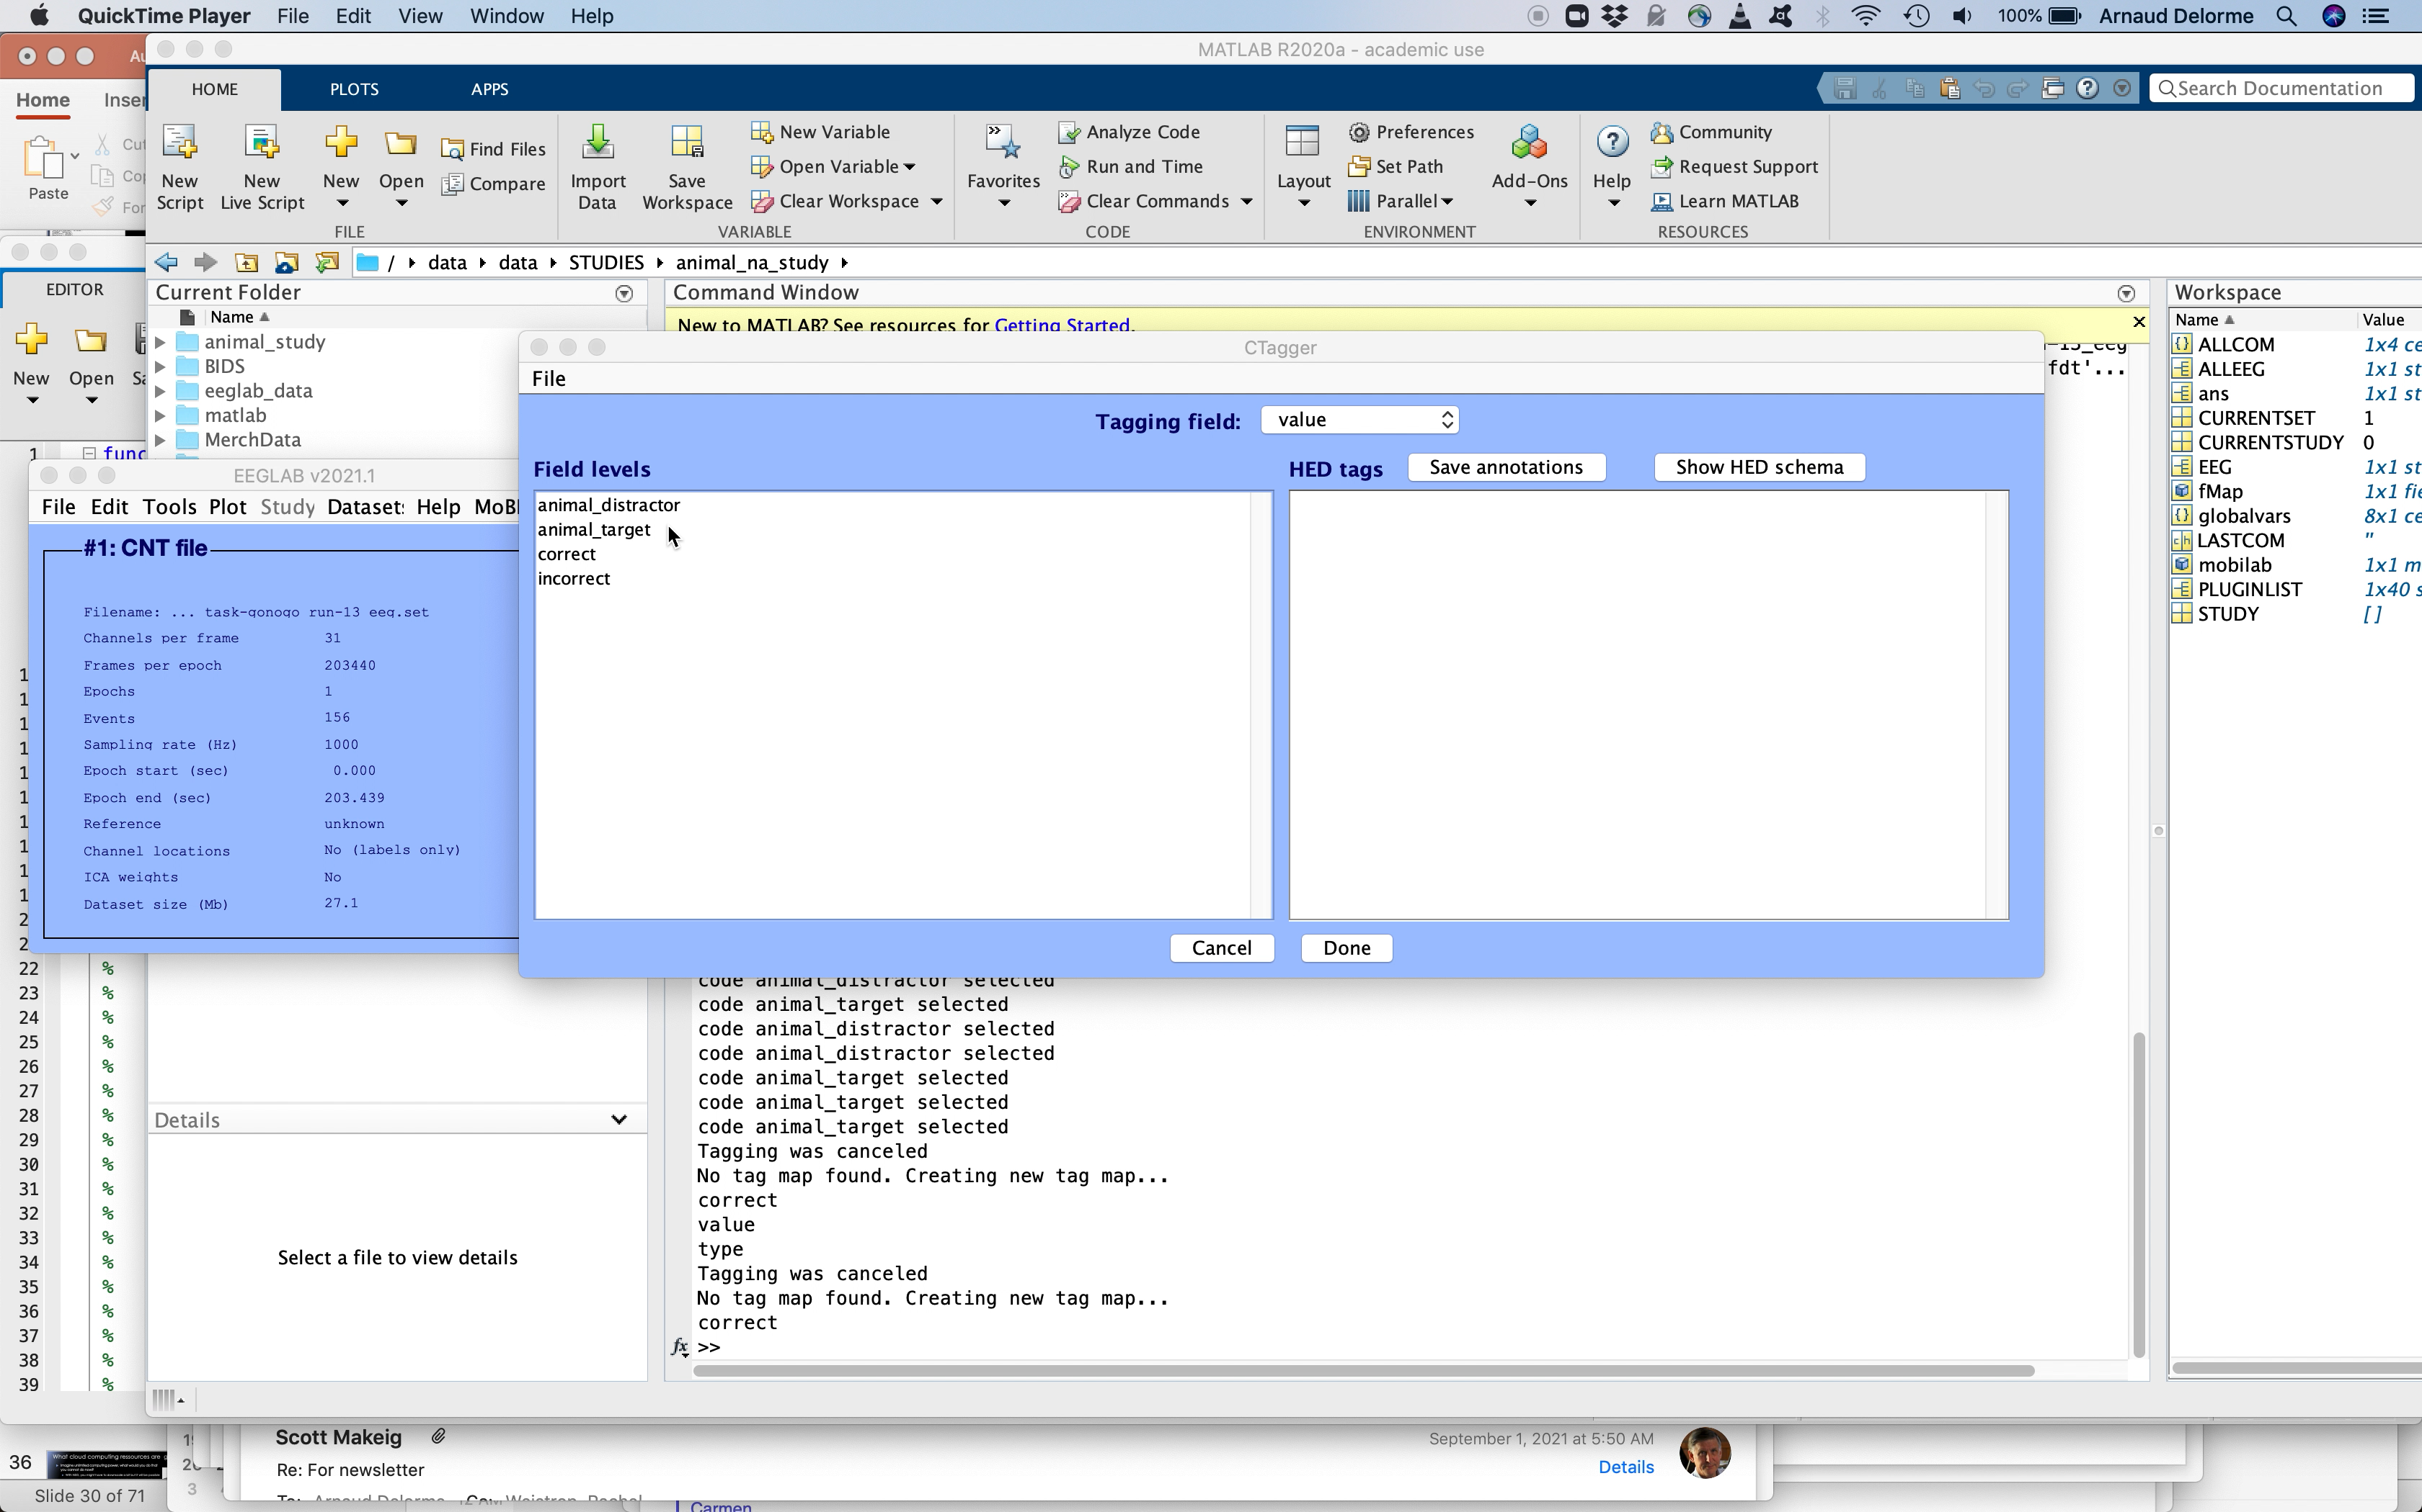

HED is integrated in

Slide 16
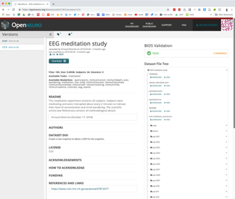


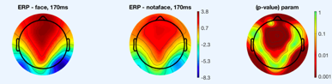
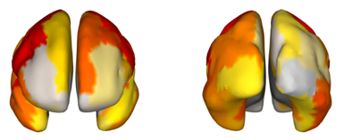
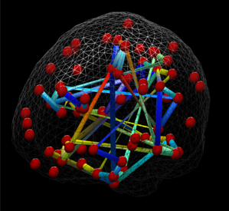
NEMAR BIDS experiment 1
ERPs and ERSPs
Automated
pipelines
NEMAR BIDS experiment 2
HED event selection
Source localization
NEMAR BIDS experiment 3
Connectivity

Slide 17
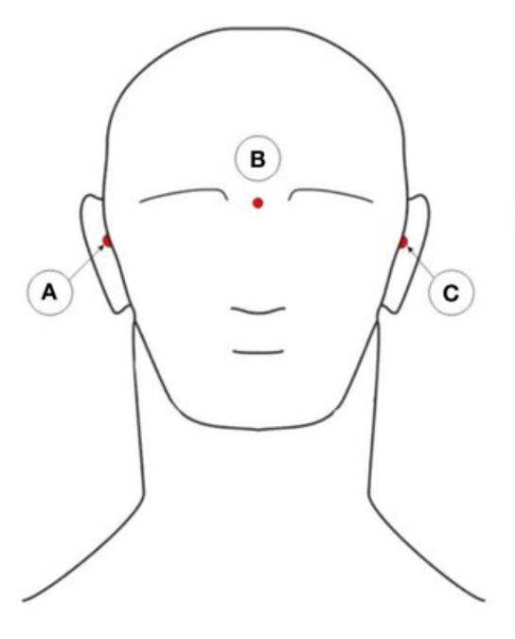
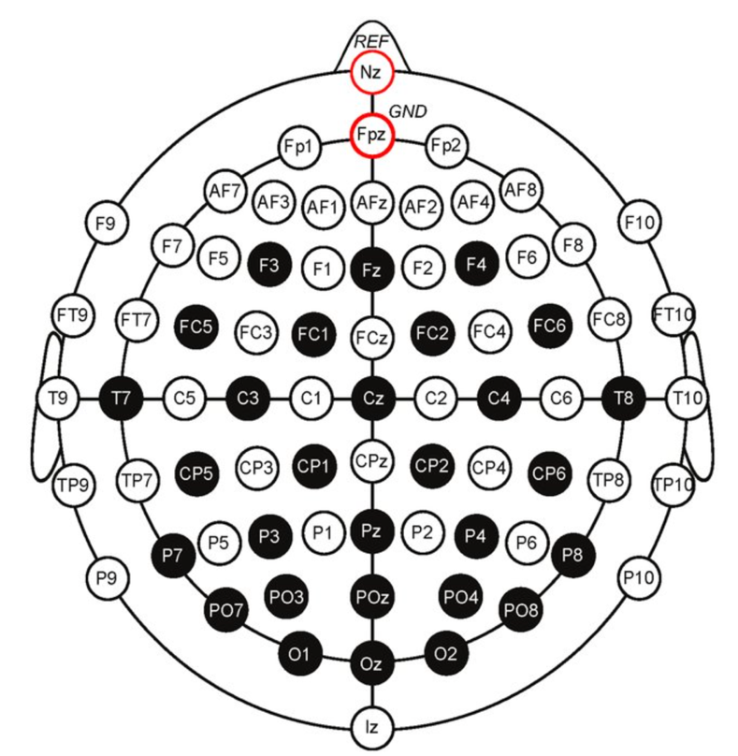
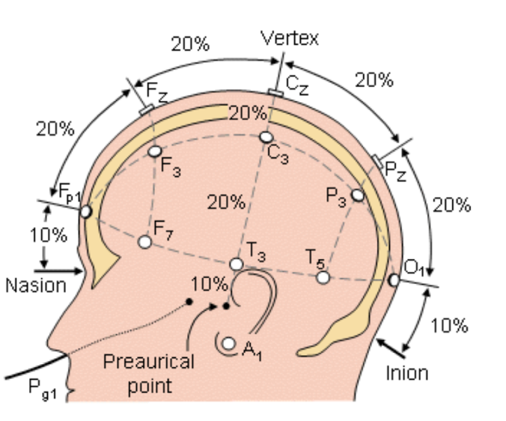
Channel labels & locations

Slide 18
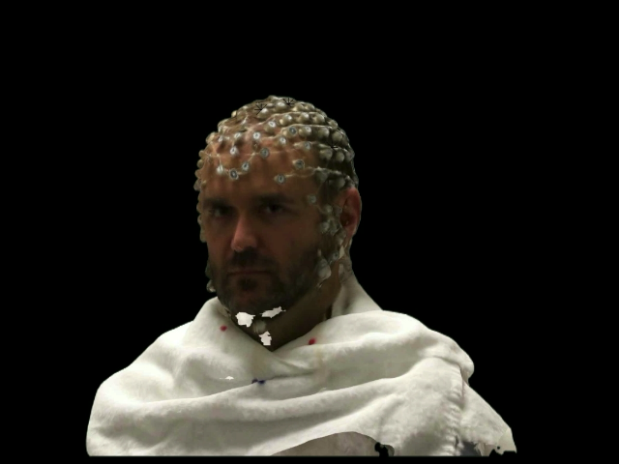
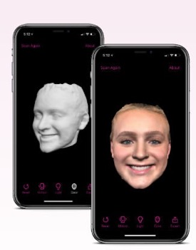
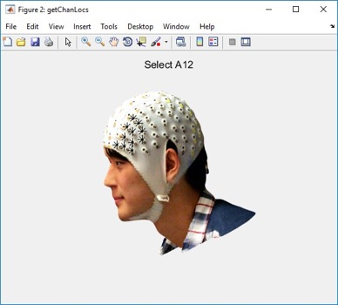

Scanning electrode position will become standard
Get_chanlocs EEGLAB plugin interfacing Fieldtrip’s functions
Smartphone 3-D scanners
EEGLAB get_chanlocs plugin
3-D camera mounted on iPad
The EEGLAB and FieldTrip teams plan to work together to automatically align scans with templates and speed up the manual electrode labeling process (after training, currently 15 minutes per subject for 64 channels)

Slide 19
Pre-processing pipeline
01.
Collect
EEG data
Import data
Import event markers
and channel locations
Re-reference/
down-sample
(if necessary)
Filter the data
Examine raw data
Identify/reject
bad channels
Reject large artifact
time points
Run ICA and
reject components
Done

Slide 20
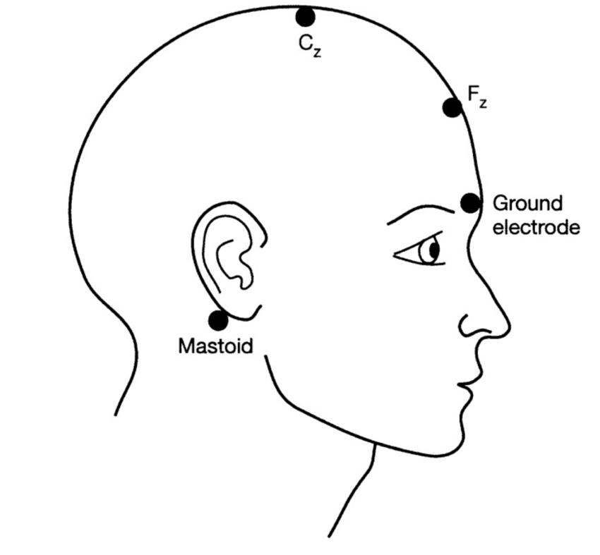
Referencing
Earlobes
Nose
Average
Mastoids
Vertex (Cz), scalp electrode
Bipolar
Infinity reference

Slide 21
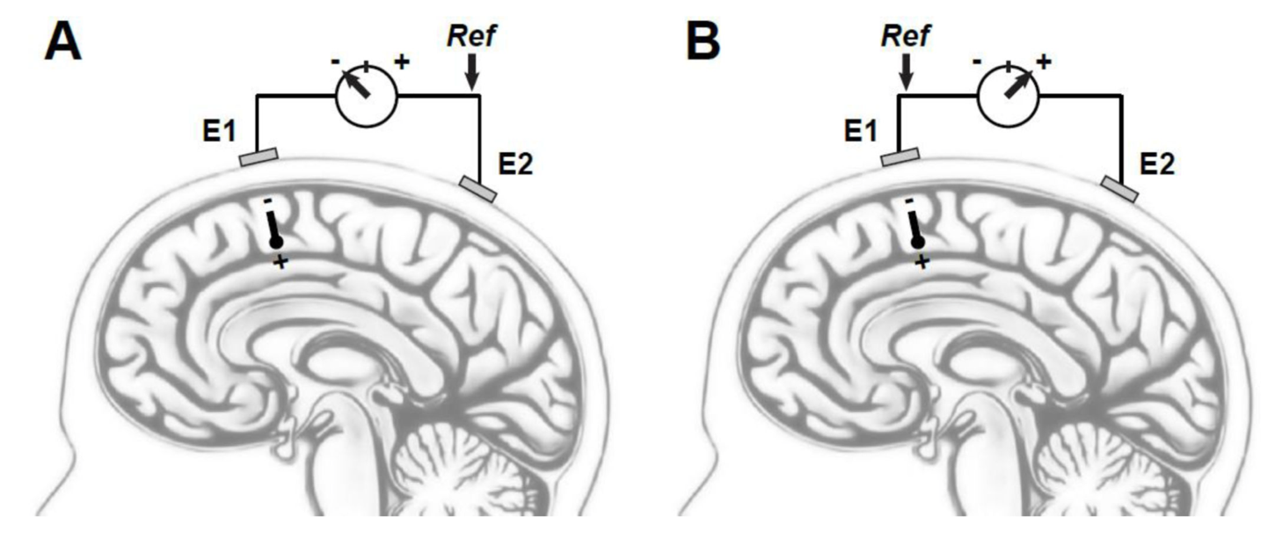
The location of the Reference matters
Kayser & Tenke, 2016

Slide 22
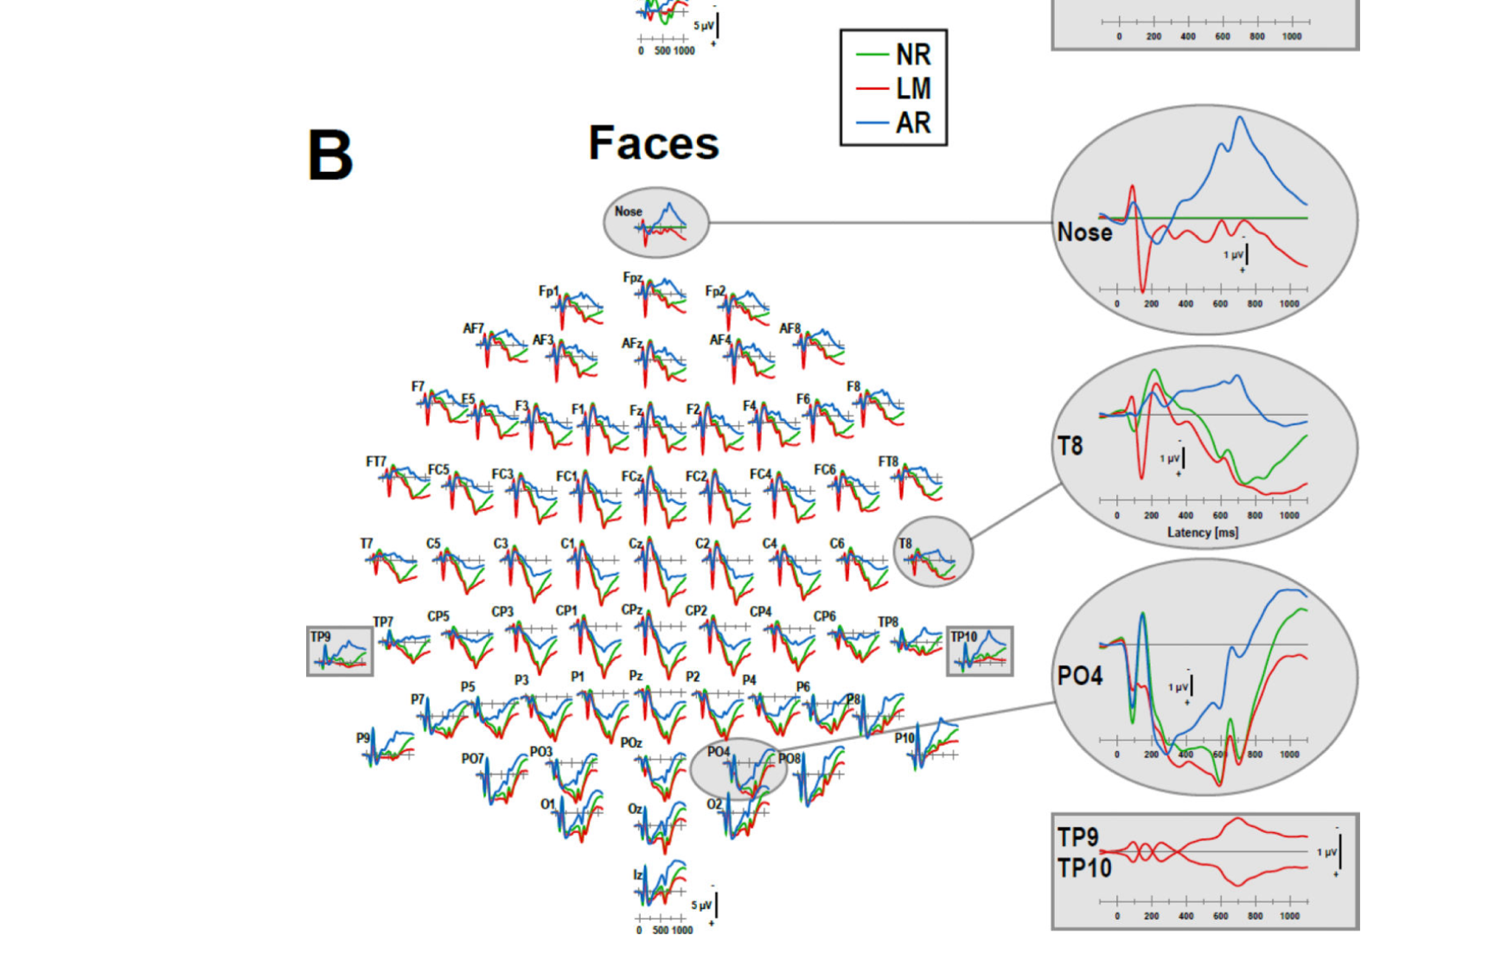
The location of Reference matters
Kayser & Tenke, 2016

Slide 23
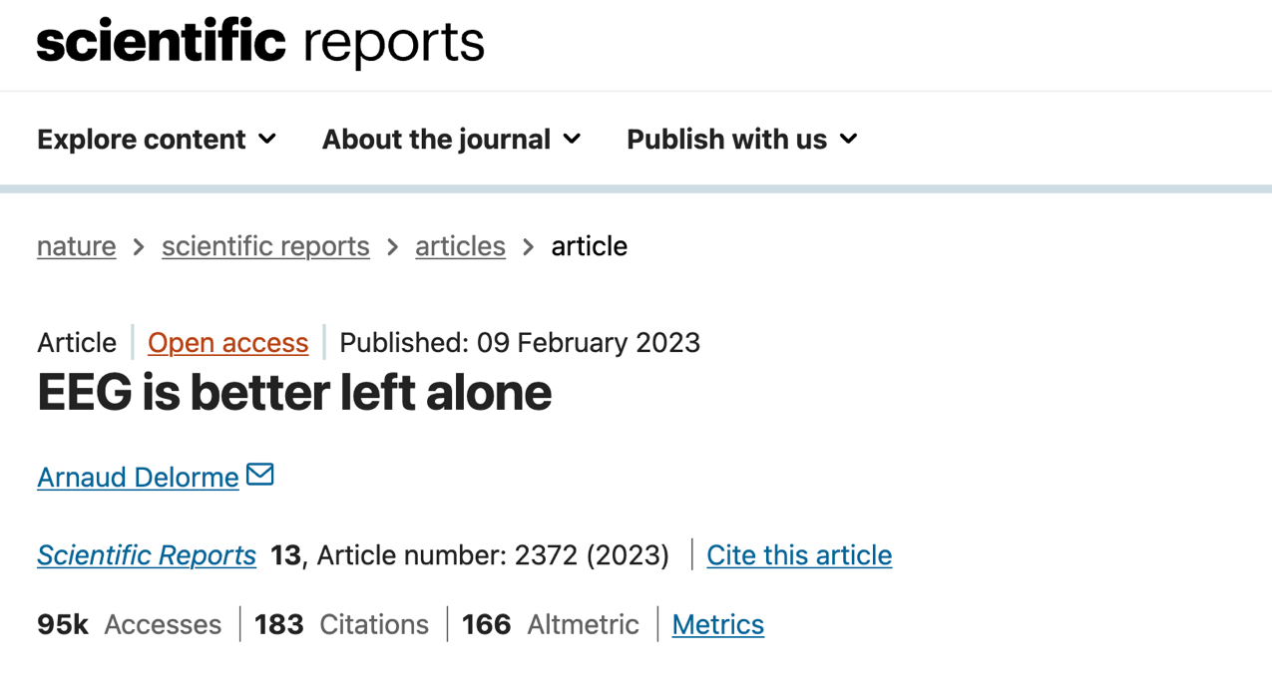

Slide 24
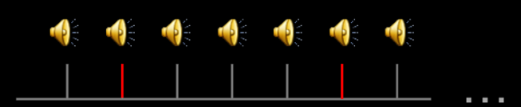
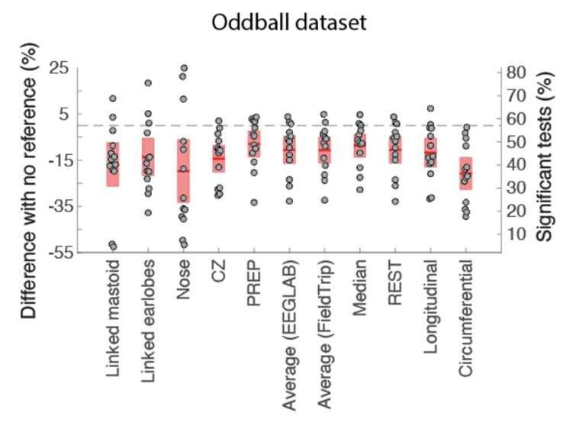
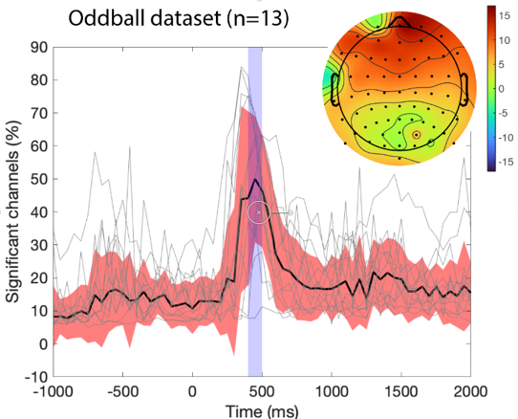
Influence of the reference on ERPs
Raw
continuous
EEG data
Import data
Preprocessing
Extract epochs
condition 1
Baseline
(none here)
Bootstrap
50 epochs
Number of
significant
channels
Extract epochs
condition 2
Baseline
(none here)
Bootstrap
50 epochs
Oddball vs. standard auditory stimuli at 450 ms (BIDS ds003061)

Slide 25
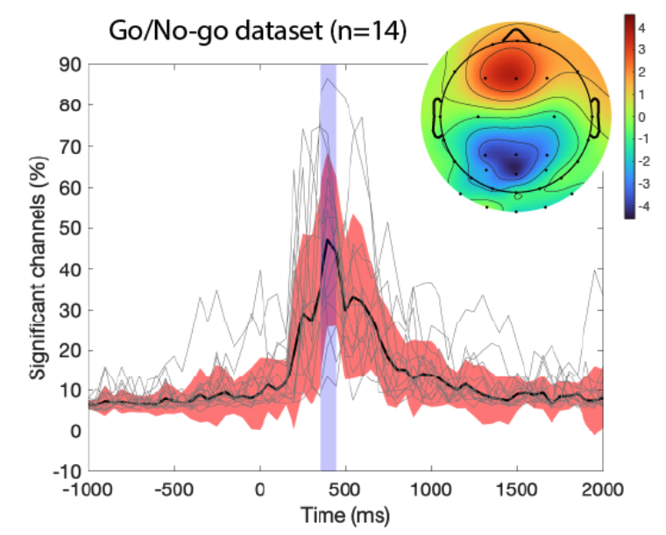
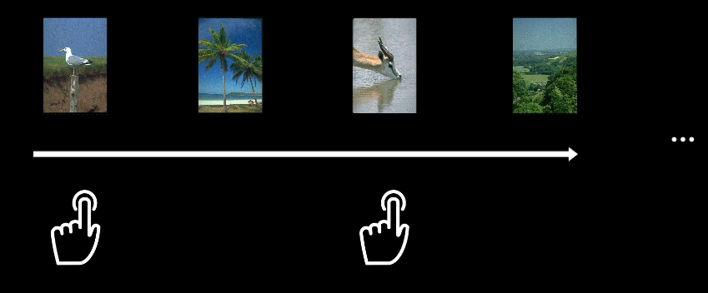
Influence of the reference on ERPs

Slide 26
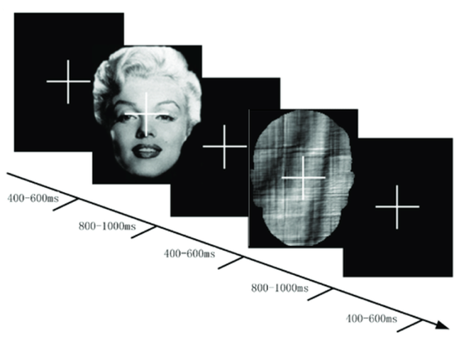
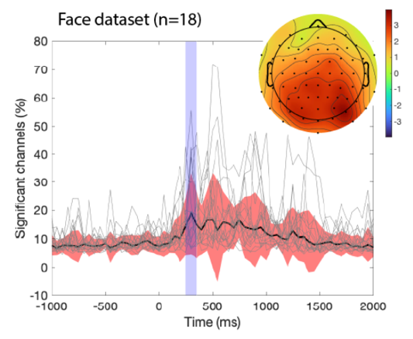

Slide 27
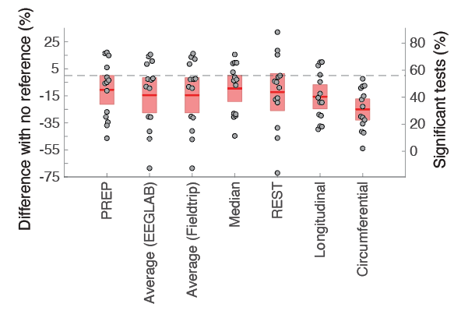
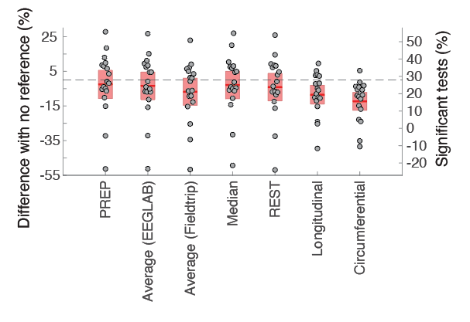
Influence of the reference on ERPs
Animal vs non-animal task
(BIDS 2680)
Face scrambled vs. famous
(dataset used at this workshop)
It is unknown why using a reference decreases the number of significant channels when comparing 2 conditions for these 3 datasets
No reference wins (REST not superior)

Slide 28
Downsampling data
500 Hz is usually enough
Reasons for lowering sampling rate
Reduce time and computational cost
Most MEEG processes are below 100 Hz. Maybe no need to keep a sample rate at 500Hz (beware of the Nyquist frequency)
Reasons for NOT lowering sampling rate
Even with MEEG amplifiers noise, information above 250 Hz (500 Hz sampling rate) might be useful for some algorithm (e.g., Independent Component Analysis)
Behavioral responses are measured on the order of millisecond – keep MEEG at the same time scale?
Notes:
Nyquist–Shannon sampling theorem (14) (or, usually any time someone mentions ‘Nyquist’ at all). Despite its fancy name, it’s really just a rule relating the information you can get out of a sampled signal. Put simply: if you are sampling at a rate of R Hz, then any signal of frequency above half of that (i.e. R/2 Hz) will be mistaken for a lower frequency. This process is also known as ‘Aliasing’, as the higher frequency is aliased to the lower one. To see why, consider the sample points (black dots), for a high-frequency signal (red) and low-frequency one (black dashes). The sampled points are identical, so a higher sampling rate is required before they can be differentiated.
For ICA for example the amount of data matters (sample points) but only sample
points that contain information so no need to keep a sampling rate of 1000Hz – 500 Hz or
even 250Hz is enough

Slide 29
Pre-processing pipeline
Collect
EEG data
Import data
Import event markers
and channel locations
Re-reference/
down-sample
(if necessary)
Filter the data
Examine raw data
Identify/reject
bad channels
Reject large artifact
time points
Run ICA and
reject components
Done

Slide 30
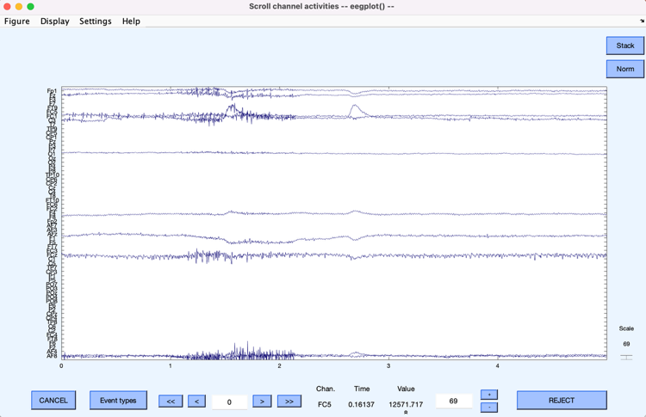
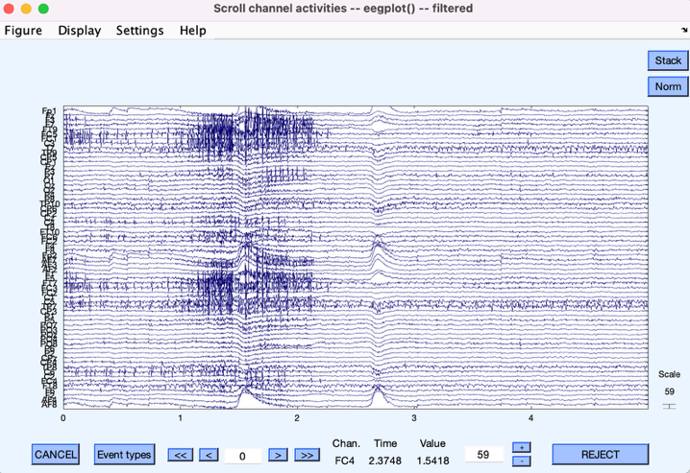
Highpass filter the data

Slide 31
Influence of HP filtering on ERPs

Slide 32
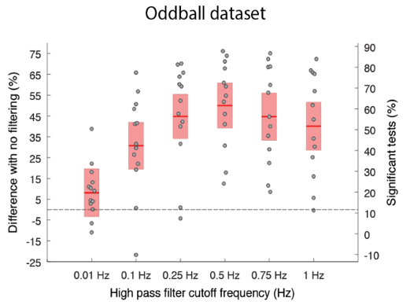
Influence of HP filtering on ERPs
Raw
continuous
EEG data
Import data
Preprocessing
(filtering)
Extract epochs
condition 1
Baseline
(none here)
Bootstrap
50 epochs
Number of
significant
channels
Extract epochs
condition 2
Baseline
(none here)
Bootstrap
50 epochs
The frequency cutoff is important
Usually 0.5Hz is a good value
The type of filter FIR or IIR is not critical
Raw data should be filtered not epochs (e.g., FieldTrip preprocessing)

Slide 33
Pre-processing pipeline
01.
Collect
EEG data
Import data
Import event markers
and channel locations
Re-reference/
down-sample
(if necessary)
Filter the data
Examine raw data
Identify/reject
bad channels
Reject large artifact
time points
Run ICA and
reject components
Done

Slide 34
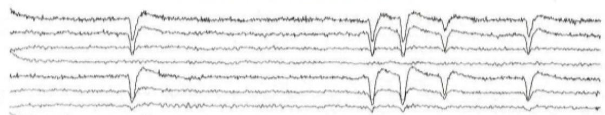
EEG artifacts
The amplitude of artifacts (such as eye movements) is often larger than the amplitude of brain data which potentially decrease signal/noise ratio, bias data analysis and potential results
EEG activity containing
potential brain data
Blink
1s

Slide 35
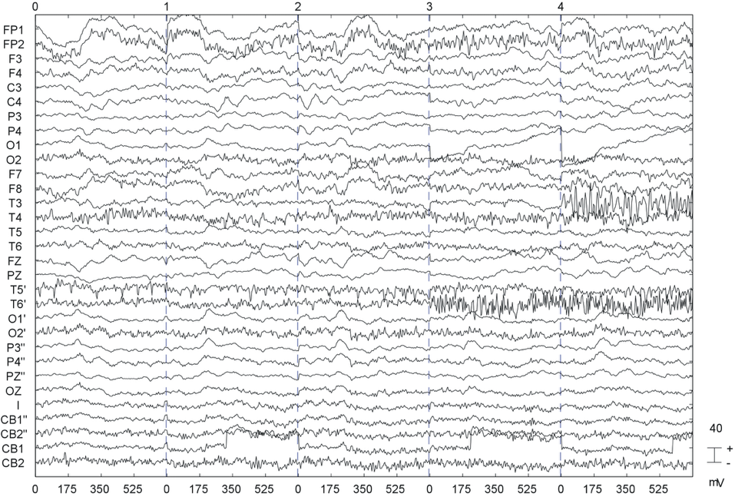
Type of artifacts
2 - Low frequency
event (eye
movements)
5 - Linear trend
P
o
t
e
n
t
i
a
l
(
m
V
3 - Discontinuity
)
Time (ms)
4 - High noise
1 - Transient high frequency
event (muscle)
Notes:
We will start from a recent finding by Scott Makeig, whom I’m working with.
This experiment shows why is interesting to work with single trials rather than averaged

Slide 36
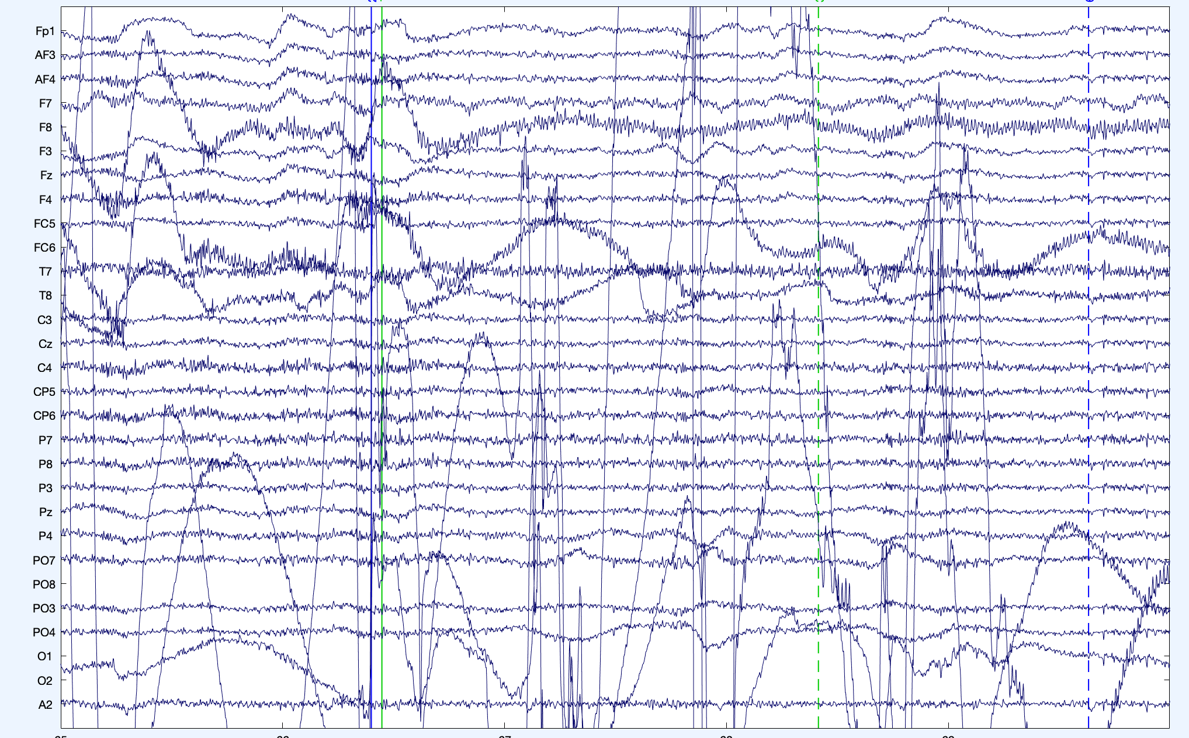
Looking for bad channels

Slide 37
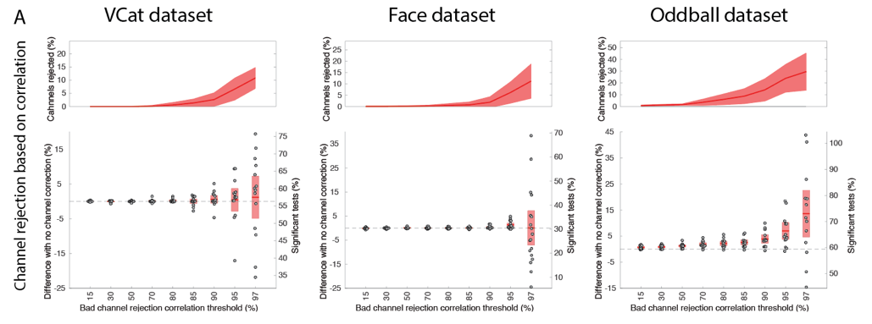
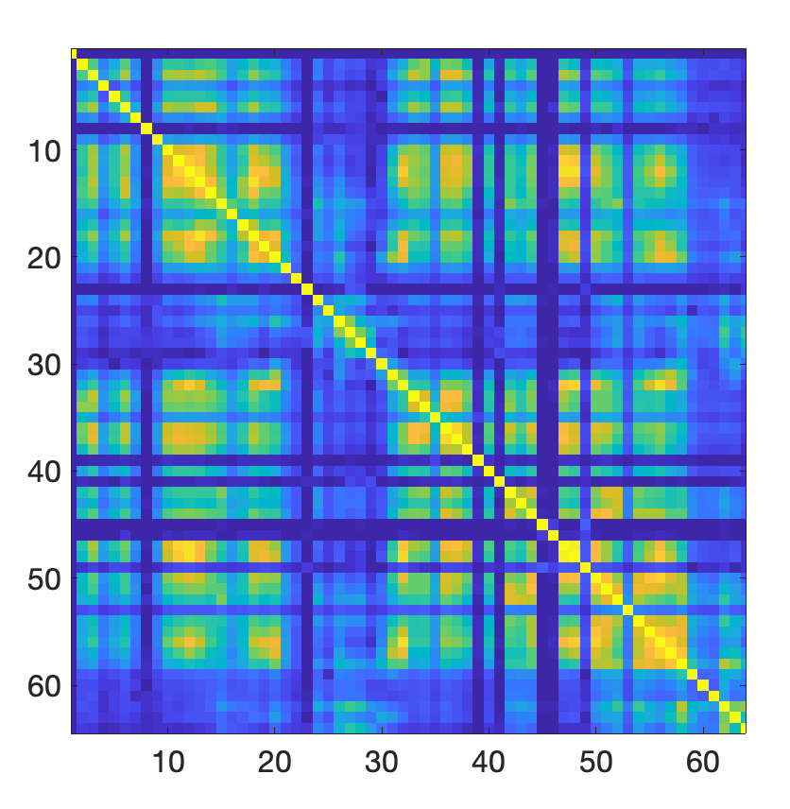
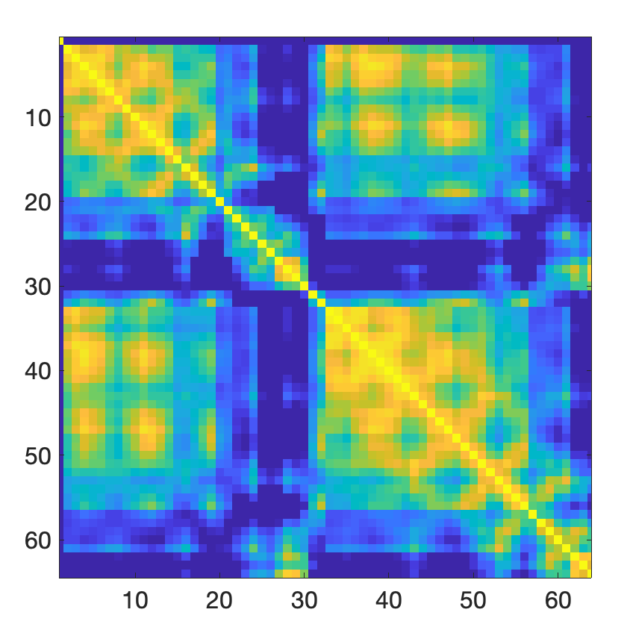
Pairwise correlation to
find bad channels
Bad data
(some uncorrelated channels)
Good data
(all channels highly correlated)
Tim R. Mullen, Christian Kothe, et al.(2015) Real-time neuroimaging and cognitive monitoring using wearable dry EEG. IEEE Transactions on Biomedical Engineering. DOI:10.1109/TBME.2015.2481482
Interpolating bad channels does not increase significance for reasonably clean data

Slide 38
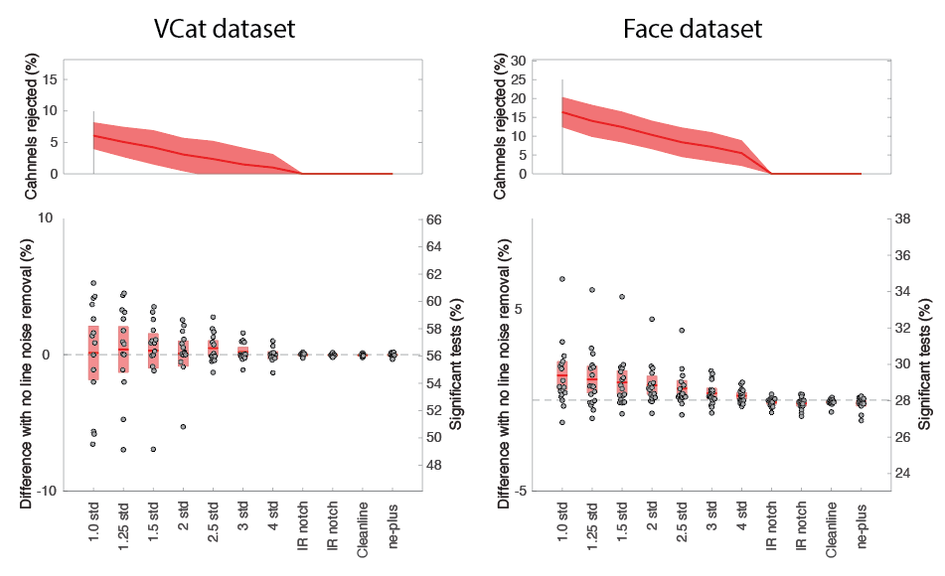

What about line noise?
Removing and interpolating noisy channel helps
Notch filtering or using line-noise removal methods does not (for these datasets)

Slide 39

Rejecting continuous data

Slide 40


The powerful ASR method
For offline analysis, ASR is usually used to detect and remove but not correct data
Tim R. Mullen, Christian Kothe, et al.(2015) Real-time neuroimaging and cognitive monitoring using wearable dry EEG. IEEE Transactions on Biomedical Engineering. DOI:10.1109/TBME.2015.2481482

Slide 41





The gold standard of artifact rejection: inter-rater agreement
100 files of 12 min
50% finding the
best algorithm
89 retained
50% testing

Slide 42




R1
BAD portion of data
R2
R3
ASR
ASR with threshold 11 is closer to each human rater than raters are with each other on the test data
A. Delorme and J. A. Martin, "Automated Data Cleaning for the Muse EEG," 2021 IEEE International Conference on Bioinformatics and Biomedicine (BIBM), 2021, pp. 1-5, doi: 10.1109/BIBM52615.2021.9669415.

Slide 43

And yet…
For reasonably clean data, ASR brings no gain
The removal of bad trials does not compensate for the loss of statistical power due to the lower trial count
Brainstorm, MNE, Fieldtrip, and other EEGLAB other automated rejection methods show no gain either

Slide 44
Pre-processing pipeline
01.
Collect
EEG data
Import data
Import event markers
and channel locations
Re-reference/
down-sample
(if necessary)
Filter the data
Examine raw data
Identify/reject
bad channels
Reject large artifact
time points
Run ICA and
reject components
Done

Slide 45

Artefact correction methods
Empirical Mode Decomposition
Wavelet Transform
Adaptive Filters
Independent Component Analysis
Canonical Correlation Analysis
Jiang et al., 2019 Sensors
Notes:
Despite its age, removing ocular artifacts via linear regression remains a popular approach because it works well in many situations. However, it is important to keep in mind that dedicated EOG electrodes placed close to the eyes must be used. In particular, if an EOG electrode fails during the recording session, the whole method breaks down. Furthermore, it is reasonable to assume that EOG electrodes will record some amount of brain activity (after all, the brain sits right behind these sensors). Therefore, this method will likely remove brain activity in addition to ocular artifacts. On the plus side, there is no restriction on the minimum number of EEG electrodes required – the regression-based approach can clean even single-channel EEG recordings.
Canonical correlation analysis (CCA) is another commonly employed BSS technique. Unlike ICA method that use higher order statistics, CCA use second order statistics which bring shorter computational time. CCA also differ from ICA in its conditions to separate components. The CCA separate components from uncorrelated sources whereas ICA from statistical independent sources
Numerous filtering methods was employed in the cancelation of artifacts from the EEG,
Numerous filtering methods was employed in the cancelation of artifacts from the EEG, for
for instance, adaptive filtering, wiener filtering and Bayes filtering, in which different methods
instance, adaptive filtering, wiener filtering and Bayes filtering, in which different methods
implemented with different principle of optimization [79]. Nevertheless, for the intention to minimize implemented with different principle of optimization [79]. Nevertheless, for the intention to minimize the mean square error between the predicted EEG and primary EEG, a weighting coefficient W will be the mean square error between the predicted EEG and primary EEG, a weighting coefficient W will adapted. F

Slide 46

46
Independent Component Analysis
ICA – separates the EEG in temporally independent source signals (Makeig, 1996)

Slide 47

Quality of Decomposition
☹
☺

Slide 48


Slide 49

Pion-Tonachini, L., Kreutz-Delgado, K., & Makeig, S. (2019). The ICLabel dataset of electroencephalographic (EEG) independent component (IC) features. Data in Brief, 25. https://doi.org/10.1016/j.dib.2019.104101

Slide 50

Automated ICA classification methods
Every method listed above is available as separate EEGLAB plugins
FieldTrip, MNE and Brainstorm can apply ICA (but automated classification are not available yet)

Slide 51

Does ICA help with ERP significance?
Sometimes a little, but the difference can also be null
Note that ICA may remove artifacts which contribute to differences between conditions (so this method of assessing performance is not ideal)

Slide 52

Should I even use ICA to remove artifacts, then?
ICLABEL
Yes, because it remove channel artifacts on scalp topographies (good for visualization)
Yes, because it may improve subsequent source localization

Slide 53



Slide 54

Hands on !
Practicing ICLabel

Slide 55


Clean_rawdata in EEGLAB
Filter the data
Channel rejection
ASR segment rejection
Final segment rejection based on simple thresholds on signal amplitude

Slide 56

Clean_rawdata in EEGLAB
Use ‘pca’, -1 when average reference is calculated to decrease the dimension of the data by 1 before ICA (we will come back to that in the ICA lecture)

Slide 57

Run ICLabel

Slide 58

Look at component class and probability of belonging to that class.

Slide 59



Let’s remove artefact ICs using IC Label classification probabilities
Either remove specific artefact ICs – here remove all ICs that have more than 80% probability to be muscle or eye components
Or remove all ICs that have less than 60% probability to be brain components (you can also choose a different probability – i.e. 70%)

Slide 60


Let’s remove artefact ICs using IC Label classification probabilities

Slide 61
Hands on: Basic preprocessing
Use menu item Tools > Reject data using clean_rawdata and ASR. Select filtering. Leave all defaults. Inspect the results (Plot > Scroll data)
Use menu item Tools > Run ICA data to run ICA
Use menu item Tools > Classify components using ICLabel > Label components, and inspect components
Note: The preprocessing is more involved. It includes referencing, an initial call to clean_rawdata to remove bad channels, ICA, then a second call to clean_rawdata to remove corrupted portions of data. This order is specific to this dataset, which contains many blink artifacts that we do not want clean_rawdata to remove because ICA handles them. The procedure is described in script_02_preprocess_data.m. Later lectures will use the output of that script. If it has not already been run for you, you will need to run it.

Slide 62
What about removing the baseline?
Collect
EEG data
Import event markers
and channel locations
Import data
Re-reference/
down-sample
(if necessary)
Filter the data
Examine raw data
Identify/reject
bad channels
Reject large artifact
time points
Run ICA and
reject components
Extract epochs
Baseline

Slide 63


Influence of the baseline on ERPs
Raw
continuous
EEG data
Import data
Preprocessing
(HP 0.5Hz)
Extract epochs
condition 1
Baseline
Bootstrap
50 epochs
Number of
significant
channels
Extract epochs
condition 2
Baseline
Bootstrap
50 epochs
Any baseline tend to decrease significance or has no effect (simply high-pass filter the data)
Short baseline are worst

Slide 64


But wait… what about baseline with minimal High-Pass
The article above advocate high-pass filter at 0.01Hz and a baseline of 100 ms
Compared to high-pass at 0.5Hz and no baseline, the number of significant channels is often cut by half
No baseline is preferable to maximize significance

Slide 65

Is there an optimal preprocessing pipeline?
Each automated artifact rejection optimized (EEGLAB, MNE, Brainstorm, Fieldtrip)
Compared to high-pass at 0.5Hz, not much improvement of any pipeline (although EEGLAB pipeline the only one significantly superior to 0.5 Hz high pass for all 3 datasets – no other pipeline superior to 0.5 Hz high pass for any dataset)
EEGLAB minor advantage due to line-noise contaminated channel interpolation and ICA automated rejection

Slide 66

Automated pre-processing pipelines available
Has test data
Please comment and help improve the automated pipeline for each software

Slide 67








The EEGLAB Youtube Channel

